Slide 1
Object oriented analysis & design
CS3C015

Slide 2
UNIT- 3
State Machine View, Activity View, Interaction View, Sequence Diagram, Collaboration Diagram.

Slide 3
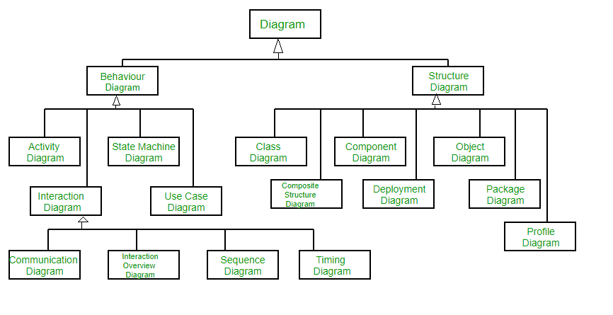
Structural and Behavioral Models

Slide 4
Behavior Diagrams –
1. State Machine Diagrams – A state diagram is used to represent the condition of the system or part of the system at finite instances of time. It’s a behavioral diagram and it represents the behavior using finite state transitions. State diagrams are also referred to as State machines and State-chart Diagrams . These terms are often used interchangeably. So simply, a state diagram is used to model the dynamic behavior of a class in response to time and changing external stimuli.

Slide 5
Behavior Diagrams –
2. Activity Diagrams – We use Activity Diagrams to illustrate the flow of control in a system. We can also use an activity diagram to refer to the steps involved in the execution of a use case. workflows visually using an activity diagram. An activity diagram focuses on condition of flow and the sequence in which it happens. We describe or depict what causes a particular event using an activity diagram.

Slide 6
Behavior Diagrams –
3. Use Case Diagrams – Use Case Diagrams are used to depict the functionality of a system or a part of a system. They are widely used to illustrate the functional requirements of the system and its interaction with external agents(actors). A use case is basically a diagram representing different scenarios where the system can be used. A use case diagram gives us a high level view of what the system or a part of the system does without going into implementation details.

Slide 7
Behavior Diagrams –
4. Sequence Diagram – A sequence diagram simply depicts interaction between objects in a sequential order i.e. the order in which these interactions take place.

Slide 8
Behavior Diagrams –
5. Communication Diagram – A Communication Diagram(known as Collaboration Diagram in UML) is used to show sequenced messages exchanged between objects. A communication diagram focuses primarily on objects and their relationships. communication diagrams represent objects and links in a free form.

Slide 9
Behavior Diagrams –
6. Timing Diagram – Timing Diagram are a special form of Sequence diagrams which are used to depict the behavior of objects over a time frame. We use them to show time and duration constraints which govern changes in states and behavior of objects.

Slide 10
behavioral modeling
Behavioral Model is specially designed to make us understand behavior and factors that influence behavior of a System. Behavior of a system is explained and represented with the help of a diagram. This diagram is known as State Transition /chart/machine Diagram
Behavioral modeling is an operational principle for all requirements analysis methods. Yet, only extended versions of structured analysis provide a notation for this type of modeling.

Slide 11


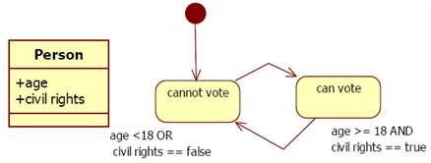
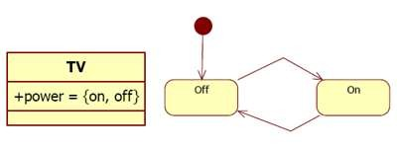
State machine diagram
A statechart diagram - shows the behavior of classes in
response to external or internal Event. This diagram models the dynamic flow of control from state to state within a system.
Statechart diagrams are useful to model reactive systems. Reactive systems can be defined as a system that responds to external or internal events.

Slide 12
Use State Machines
at an early stage of software development
when behavior of an object (lifecycle) or operation is not well understood yet
Do NOT use State Machines
when several objects are involved (interaction diagrams
are better)

Slide 13
state chart diagram: components
States—values of an object’s attributes at a point in time
Events—the cause of the change in values of the object’s attributes
Transitions—movement of an object from one state to another

Slide 14
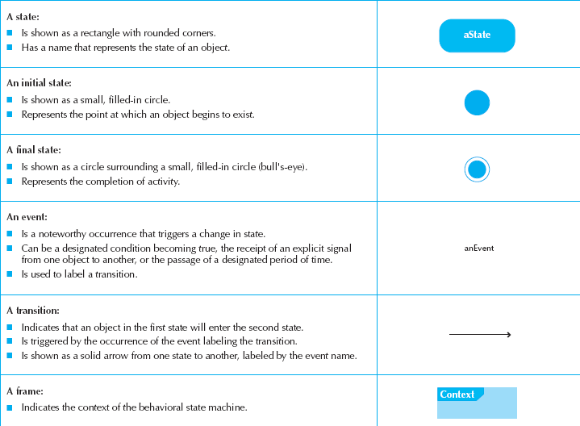
state chart diagram: components

Slide 15
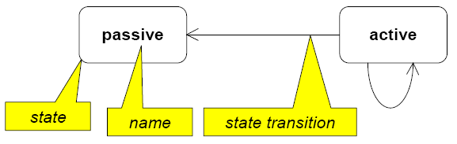
1. States (a mode of the entity).
simple states
composite states (nested state diagrams)
State – Constraint or condition or situation during which an object/instance may perform some activity; The state of an object is characterized by the value of one or more of its attributes.

Slide 16







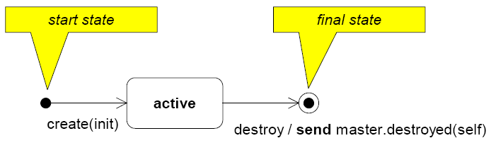
Start state: State transition is executed immediately during the creation of the object.
Only possible event: create (parameter)
Java: constructor (new)
Final State: destruction of the object

Slide 17


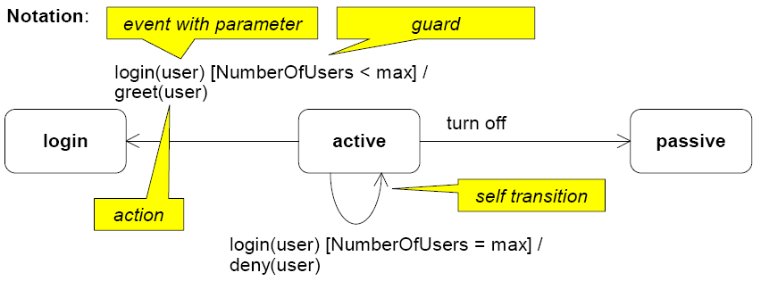
A transition connects two states and shows the flow of control.
A transition can include a triggering event, a guard and actions to be executed.
Transitions without event and guard are executed immediately when an activity is finished respectively all sub states were passed through.

Slide 18

An event is a noteworthy occurrence that has a location in space or time.
It occurs at a point in time .
An event can appear synchronously or asynchronously.
Types of Events:-
Call event:
Signal event:
Change event:
Time event:

Slide 19
1. Call events:- are synchronous, i.e., the sender waits until the receiver reacted on the event.
The receiver can:
ignore the event (the event is lost),
execute its trigger event or
execute an operation.
2. Signals Events:- are asynchronous, i.e., the sender does not wait until the receiver received the signal or reacted on it.

Slide 20


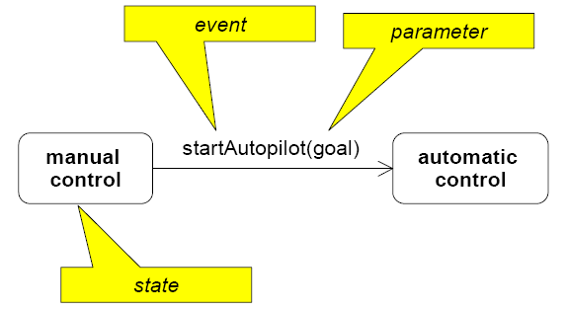
Represents the dispatch of an operation
Name and parameter of the event must be compatible to methods of the class.

Slide 21


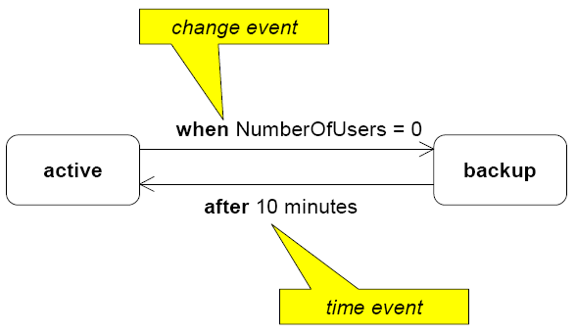
3. Time event:- appears after the expiration of a time period.
4. Change event:- occurs if a specific constraint is fulfilled. The constraint is a Boolean
Expression on the attributes of the actual object.

Slide 22


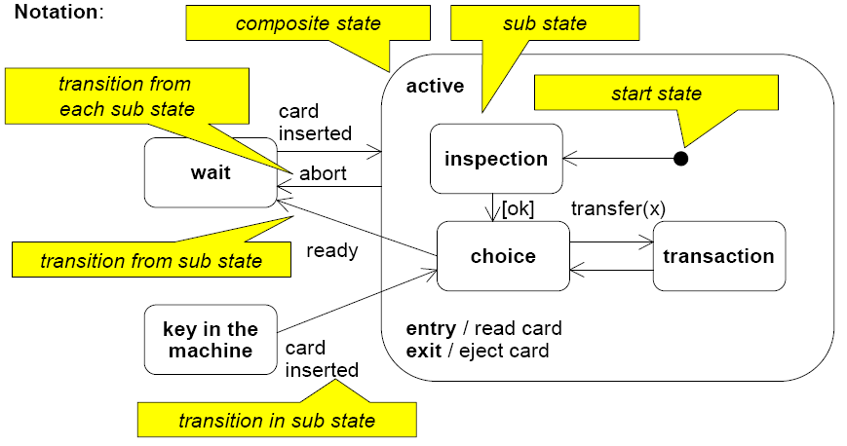
A state can be refined hierarchically by composite states.

Slide 23


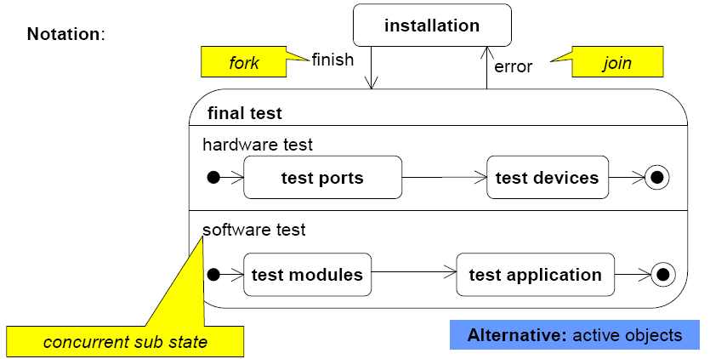
In a state several sequences of sub states described by own state machines can be performed concurrently.

Slide 24
state chart diagram: Guidelines for
Use only for complex objects
Draw the initial state in the upper left corner
Draw the final state in the bottom right corner
Use simple, but descriptive names for states
Look out for “black holes” and “miracles”
Ensure guard conditions are mutually exclusive
Ensure transitions are associated with messages and operations

Slide 25
state chart diagram: Building diagram
Set the context
Identify the states of the object
Initial
Final
Stable states during its lifetime
Lay out the diagram—use a left to right sequence
Add the transitions
Identify the triggers (events that cause the transition)
Identify the actions which execute
Identify the guard conditions
Validate the model—ensure all states are reachable

Slide 26
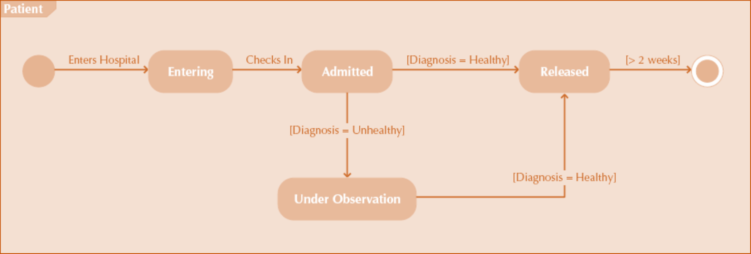
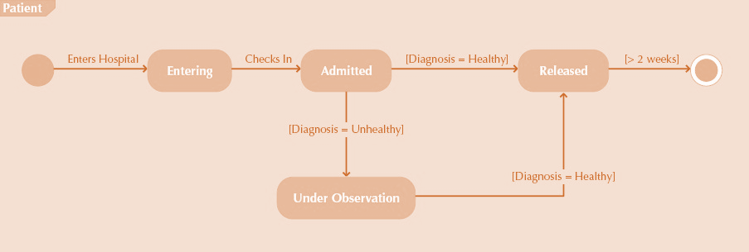
state chart diagram: example

Slide 27
state chart diagram: example
Consider an Elevator. This elevator is for n number of floors and has n number of buttons one for each floor.
Elevator buttons are type of set of buttons which is there on elevator. For reaching a particular floor you want to visit, “elevator buttons” for that particular floor is pressed. Pressing, will cause illumination and elevator will start moving towards that particular floor for which you pressed “elevator buttons”. As soon as elevator reaches that particular floor, illumination gets canceled.

Slide 28
state chart diagram: example
Floor buttons are another type of set of buttons on elevator. If a person is on a particular floor and he wants to go on another floor, then elevator button for that floor is pressed. Then, process will be same as given above. Pressing, will cause illumination and elevator to start moving, and when it reaches on desired floor, illumination gets canceled.
When there is no request for elevator, it remains closed on current floor.

Slide 29
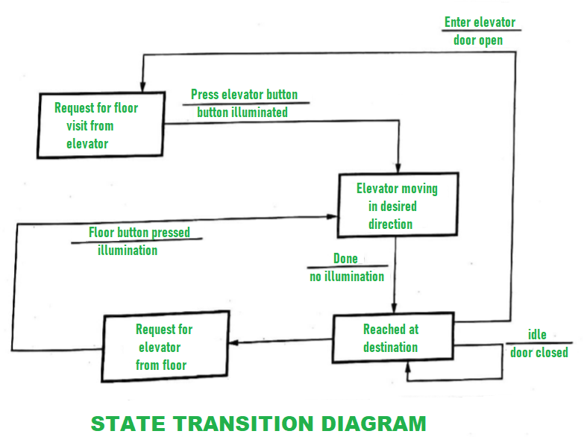
state chart diagram: example

Slide 30



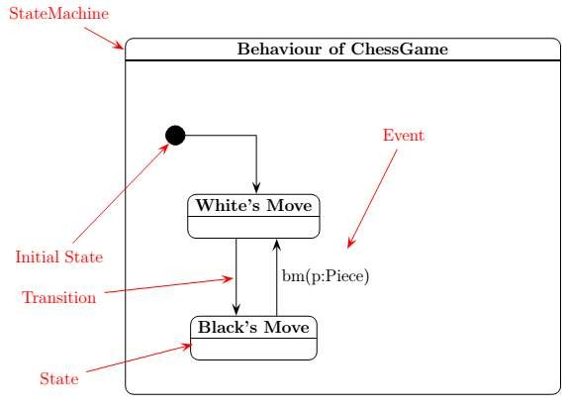
A chess game consists of alternate moves of Black and White. White moves first.
The game can end both when it is White’s and when it is Black’s turn.
The moving player can end the game: winning (checkmate), loosing (resign), or with a draw.

Slide 31

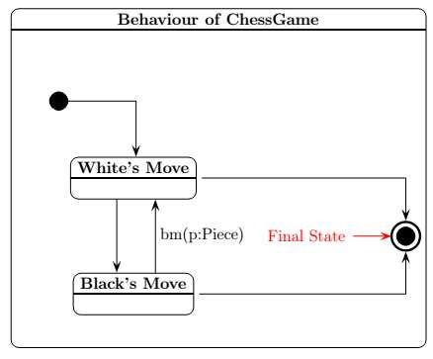
A chess game consists of alternate moves of Black and White. White moves first.
The game can end both when it is White’s and when it is Black’s turn.
The moving player can end the game: winning (checkmate), loosing (resign), or with a draw.

Slide 32

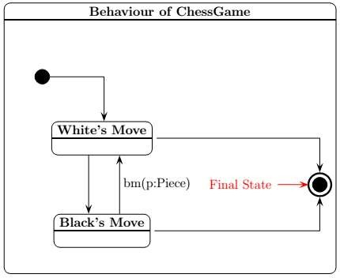
A chess game consists of alternate moves of Black and White. White moves first.
The game can end both when it is White’s and when it is Black’s turn.
The moving player can end the game: winning (checkmate), loosing (resign), or with a draw.

Slide 33

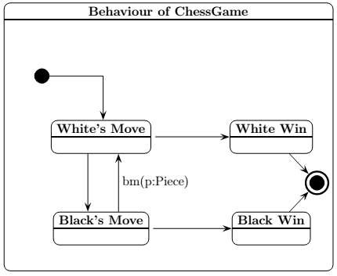
A chess game consists of alternate moves of Black and White. White moves first.
The game can end both when it is White’s and when it is Black’s turn.
The moving player can end the game: winning (checkmate), loosing (resign), or with a draw.

Slide 34

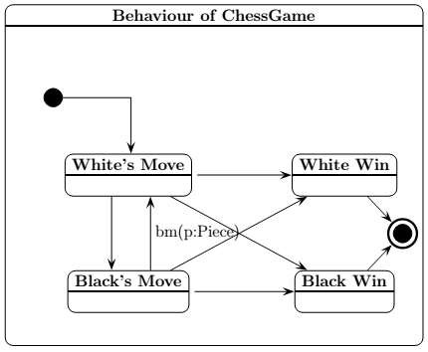
A chess game consists of alternate moves of Black and White. White moves first.
The game can end both when it is White’s and when it is Black’s turn.
The moving player can end the game: winning (checkmate), loosing (resign), or with a draw.

Slide 35

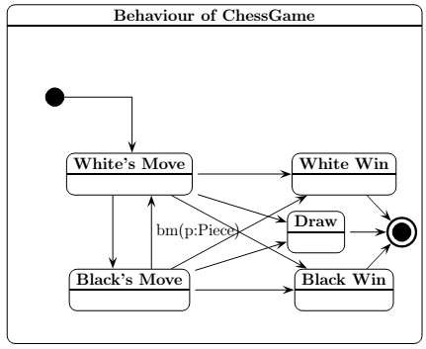
A chess game consists of alternate moves of Black and White. White moves first.
The game can end both when it is White’s and when it is Black’s turn.
The moving player can end the game: winning (checkmate), loosing (resign), or with a draw.

Slide 36


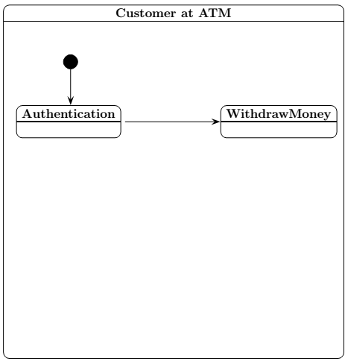
The customer must pass authentication before withdrawing money.
Authentication is done by checking a PIN.
The PIN can be corrector
not.
Unsuccessful attempts are counted,
If the counter exceeds a limit, the customer is rejected.

Slide 37

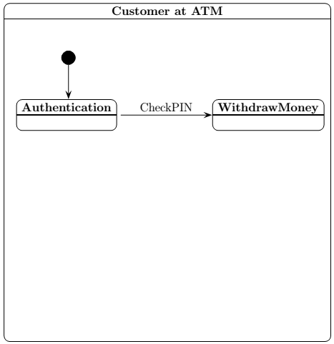
The customer must pass authentication before withdrawing money.
Authentication is done by checking a PIN.
The PIN can be corrector not.
Unsuccessful attempts are counted,
If the counter exceeds a limit, the customer is rejected.

Slide 38

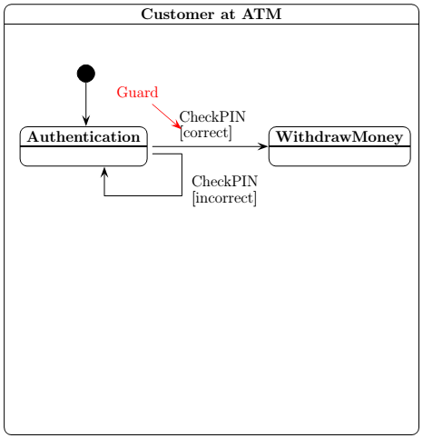
The customer must pass authentication before withdrawing money.
Authentication is done by checking a PIN.
The PIN can be corrector not.
Unsuccessful attempts are counted,
If the counter exceeds a limit, the customer is rejected.

Slide 39

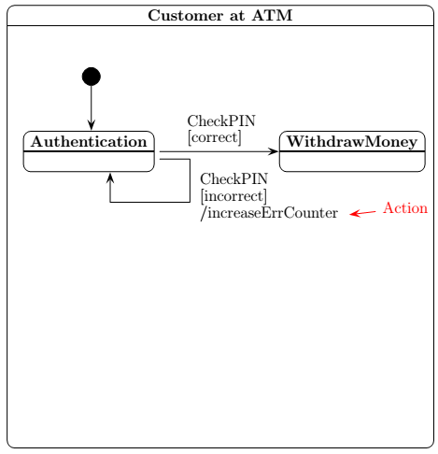
The customer must pass authentication before withdrawing money.
Authentication is done by checking a PIN.
The PIN can be corrector not.
Unsuccessful attempts are counted,
If the counter exceeds a limit, the customer is rejected.

Slide 40

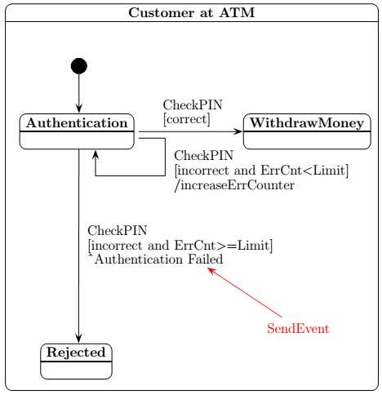
The customer must pass authentication before withdrawing money.
Authentication is done by checking a PIN.
The PIN can be corrector not.
Unsuccessful attempts are counted,
If the counter exceeds a limit, the customer is rejected.

Slide 41

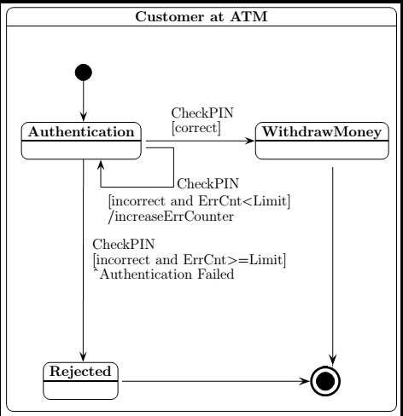
The
pass
customer must
authentication withdrawing
before money.
Authentication
is by checking a
PIN can be
done PIN.
The
corrector not.
Unsuccessful attempts counted,
If the
are
counter
exceeds a limit, the
customer is rejected.

Slide 42


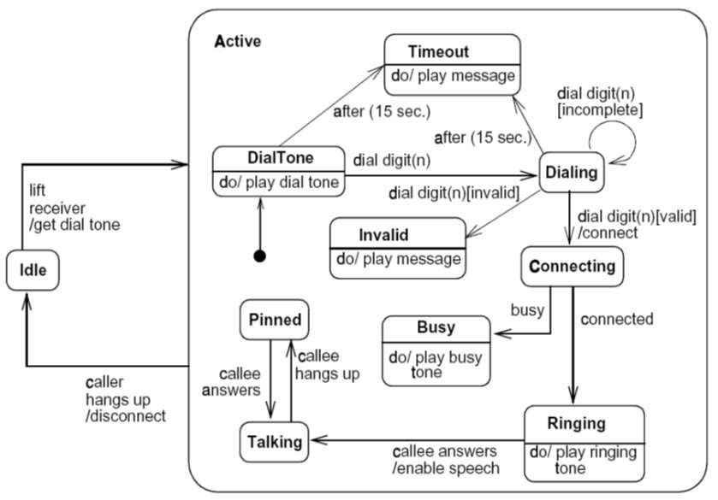

Slide 43


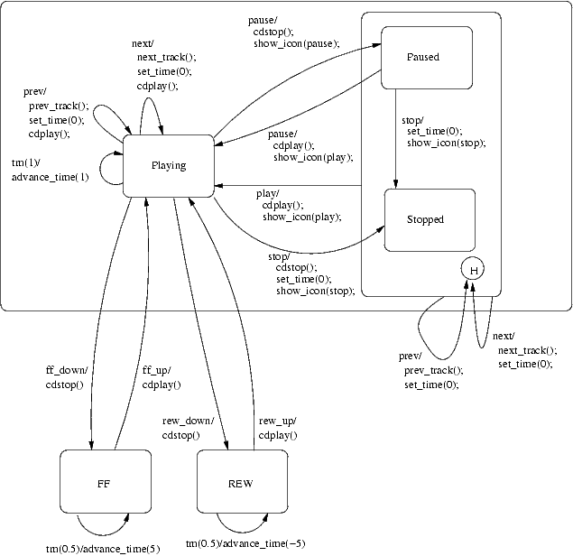

Slide 44
Activity diagram
the activity diagram is used visually represent a series of actions/ flow of control within the system.
It models the concurrent and sequential activities.
An activity graph assumes that computations proceeds without external event based interruptions.
Activity is a particular operation of the system. Activity diagrams are not only used for visualizing the dynamic nature of a system, but they are also used to construct the executable system by using forward and reverse engineering techniques.

Slide 45
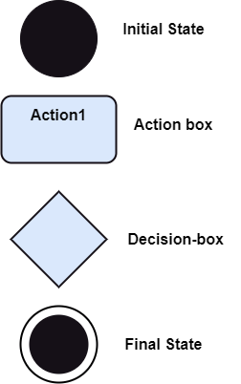
Components of activity diagram
Activity diagram constitutes following notations:
Initial State: It depicts the initial stage or beginning of the set of actions.
Action Box: It represents the set of actions that are to be performed.
Decision Box: It makes sure that the control flow or object flow will follow only one path.
Final State: It is the stage where all the control flows and object flows end.

Slide 46
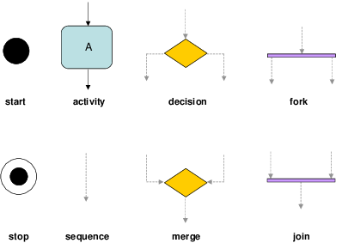
Components of activity diagram

Slide 47
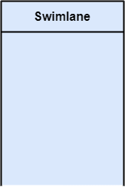
Components of activity diagram
The swimlane is used to cluster all the related activities in one column or one row. It can be either vertical or horizontal. It used to add modularity to the activity diagram.

Slide 48
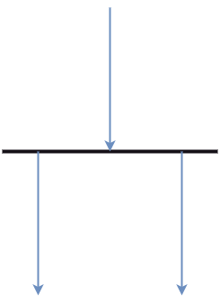
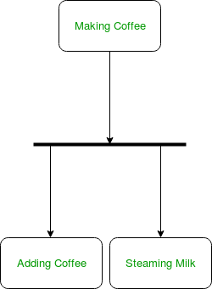
Components of activity diagram
A fork node consists of one inward edge and several outward edges. It is the same as that of various decision parameters. Whenever a data is received at an inward edge, it gets copied and split crossways various outward edges. It split a single inward flow into multiple parallel flows.

Slide 49
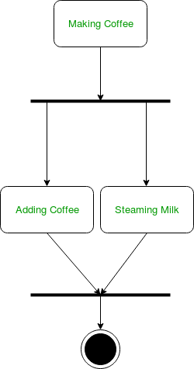
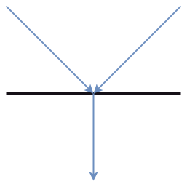
Components of activity diagram
Join nodes are the opposite of fork nodes. A Logical AND operation is performed on all of the inward edges as it synchronizes the flow of input across one single output (outward) edge.

Slide 50
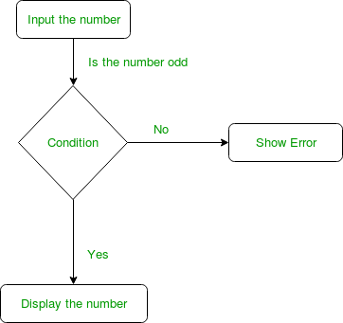
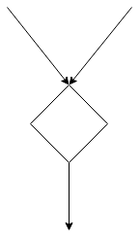
Components of activity diagram
Merge Event:- brings together multiple flows that are not concurrent.

Slide 51
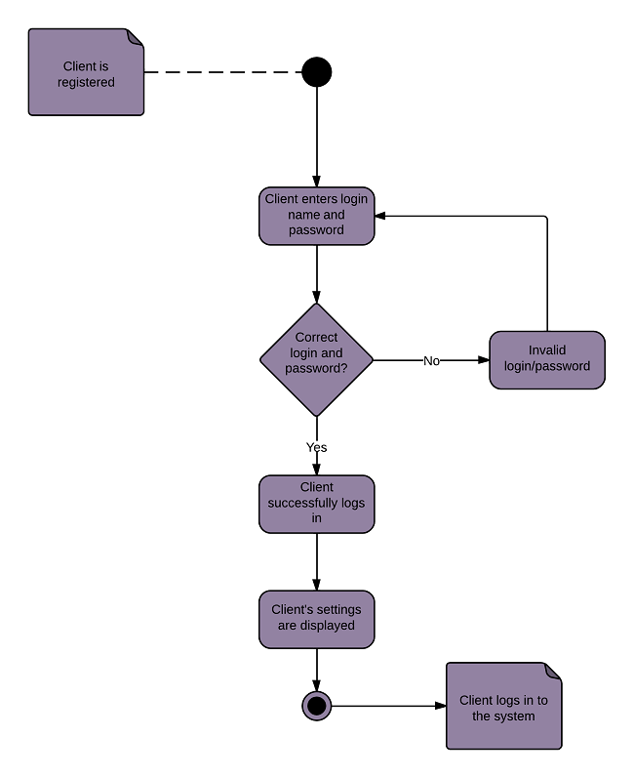

Slide 52
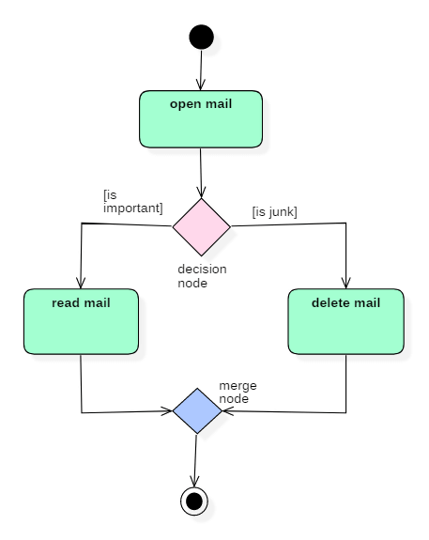

Slide 53
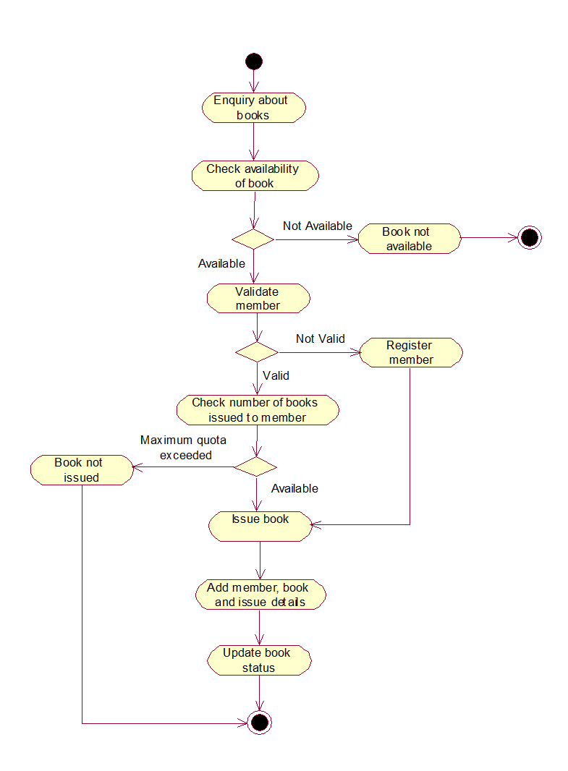

Slide 54
Swim lane diagram
A swimlane or swimlane diagram is a type of activity diagram that shows who is responsible for each part of a process. The name references the lanes you'd see in a swimming pool, with each lane acting as a space for a business role or department. Swimlanes are also called Functional Bands, Multi-Column Charts, or Rummler-Brache diagrams
To communicate and highlight which process steps or sub-processes are assigned to a particular actor within an organization, thus helping everyone involved know who is doing what.

Slide 55
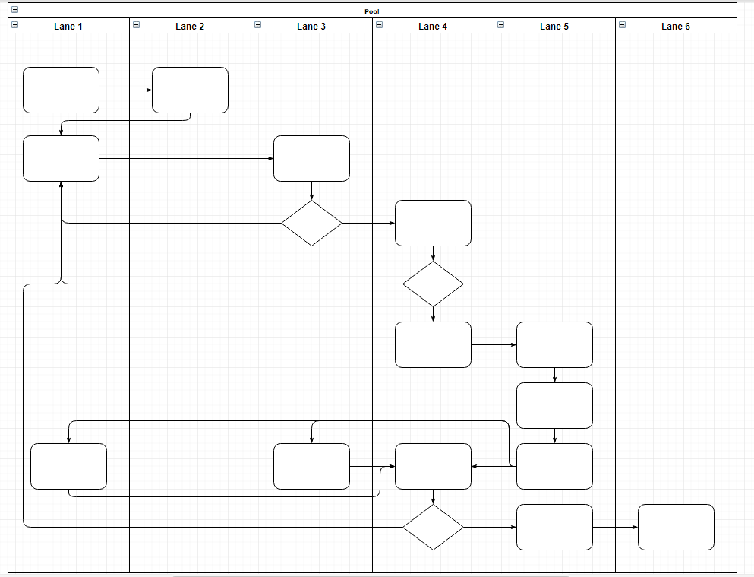

Slide 56
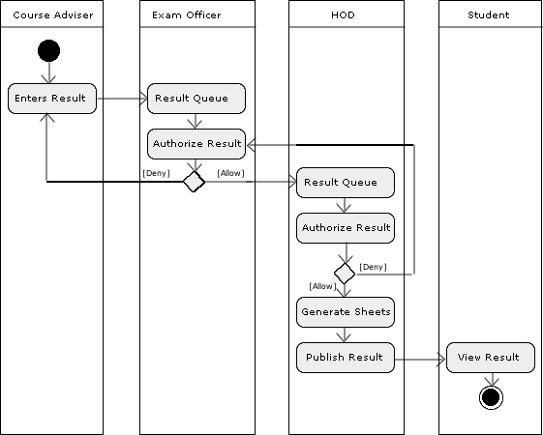

Slide 57
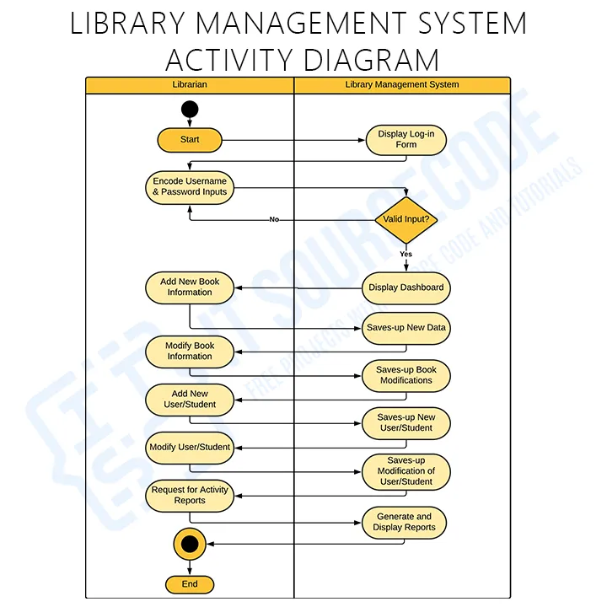

Slide 58
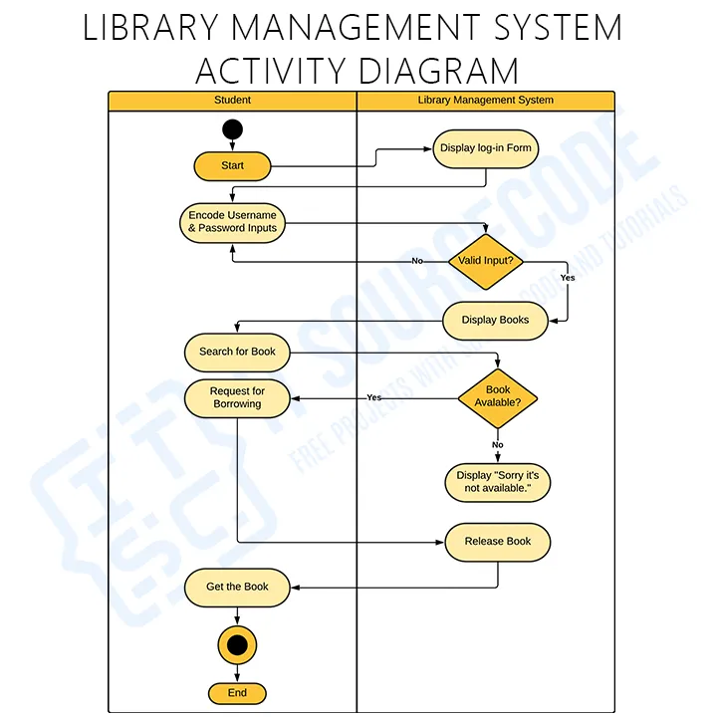

Slide 59
Interaction view
From the term Interaction, it is clear that the diagram is used to describe some type of interactions among the different elements in the model. This interaction is a part of dynamic behavior of the system.

Slide 60
Interaction view
Purpose of Interaction Diagrams
The purpose of interaction diagrams is to visualize the interactive behavior of the system. Visualizing the interaction is a difficult task. Hence, the solution is to use different types of models to capture the different aspects of the interaction.

Slide 61
Aims of Interaction Diagram
It visualizes the message flow and the interaction within the system.
It displays the sequenced interaction order inside the system.
It shows the architecture of the object-oriented system and envisions the real-time data.
It envisions the dynamic behavior of the system.
It depicts the entity’s structural aspects inside the system.

Slide 62
Usage of the Interaction Diagram
It standardizes the interactive element’s structure.
It also designs a system as the time-ordered sequence of the system.
It finely expresses the dynamic nature of a system.
The interaction diagram is engaged to identify newer applications.
It also depicts the control flow order from one component to another component within the system.

Slide 63
Interaction view: types
Communication diagram
Sequence diagram
Timing diagram
Interaction overview diagram

Slide 64
Interaction view: types
1. Communication Diagram:- In UML, communication diagrams depict the relationships and interactions among various software objects. They emphasize the structural aspects of an interaction diagram, focusing on object architecture rather than the flow of messages.

Slide 65
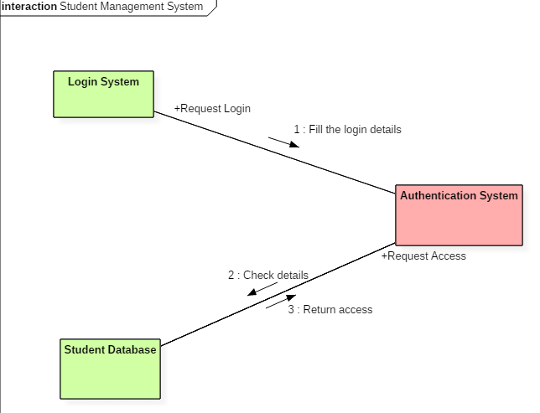
Collaboration diagram

Slide 66
Interaction view: types
2. A Sequence Diagram:- simply depicts interaction between objects in a sequential order. The purpose of a sequence diagram in UML is to visualize the sequence of a message flow in the system.

Slide 67
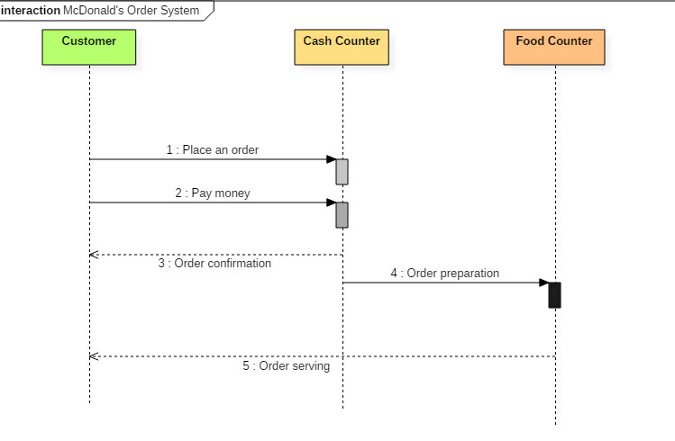
Sequence diagram

Slide 68
Interaction view: types
Timing Diagram is a waveform or a graph that is used to describe the state of a lifeline at any instance of time. It is used to denote the transformation of an object from one form into another form. Timing diagram does not contain notations as required in the sequence and collaboration diagram

Slide 69
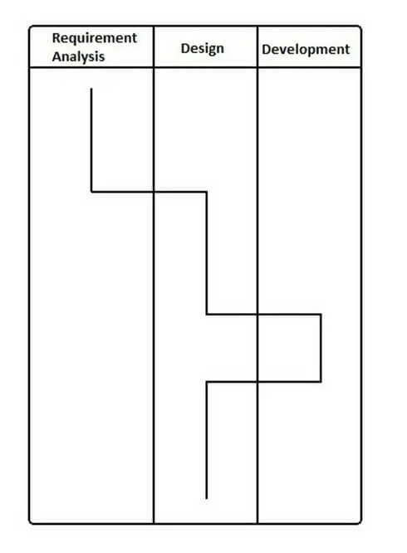
Timing diagram

Slide 70
Interaction view: types
The interaction overview diagram provides a high-level view of an interaction model. The diagram acts as an overview of the flow of control from interaction to interaction, as well as the flow of activity from diagram to diagram.

Slide 71
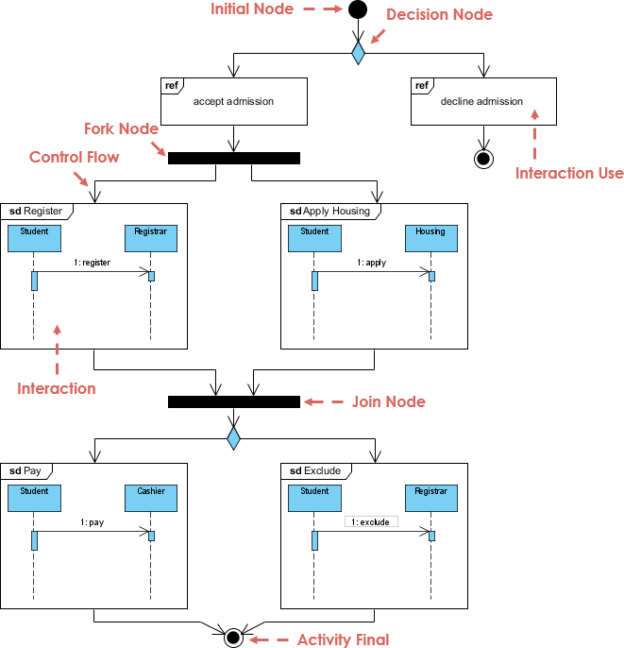
Interaction overview diagram

Slide 72
Interaction view: collaboration diagram
A collaboration diagram, also known as a communication diagram, is an illustration of the relationships and interactions among software objects in the Unified Modeling Language. These diagrams can be used to portray the dynamic behavior of a particular use case and define the role of each object.

Slide 73
Notations of a Collaboration Diagram
Objects: The representation of an object is done by an object symbol with its name and class underlined, separated by a colon. In the collaboration diagram, objects are utilized in the following ways:
The object is represented by specifying their name and class.
It is not mandatory for every class to appear.
A class may constitute more than one object.
In the collaboration diagram, firstly, the object is created, and then its class is specified.
To differentiate one object from another object, it is necessary to name them.

Slide 74
Notations of a Collaboration Diagram
Actors: In the collaboration diagram, the actor plays the main role as it invokes the interaction. Each actor has its respective role and name. In this, one actor initiates the use case.
Links: The link is an instance of association, which associates the objects and actors. It portrays a relationship between the objects through which the messages are sent. It is represented by a solid line. The link helps an object to connect with or navigate to another object, such that the message flows are attached to links.

Slide 75
Notations of a Collaboration Diagram
Messages: It is a communication between objects which carries information and includes a sequence number, so that the activity may take place. It is represented by a labeled arrow, which is placed near a link. The messages are sent from the sender to the receiver, and the direction must be navigable in that particular direction. The receiver must understand the message.

Slide 76
Steps for creating a Collaboration Diagram
Determine the behavior for which the realization and implementation are specified.
Discover the structural elements that are class roles, objects, and subsystems for performing the functionality of collaboration.
Choose the context of an interaction: system, subsystem, use case, and operation.
Think through alternative situations that may be involved.
Implementation of a collaboration diagram at an instance level, if needed.
A specification level diagram may be made in the instance level sequence diagram for summarizing alternative situations.

Slide 77
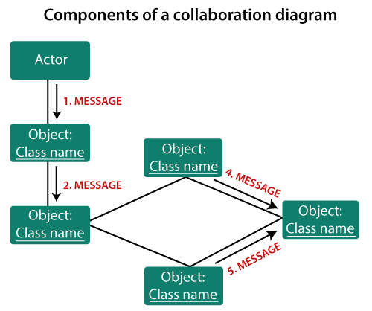

Slide 78
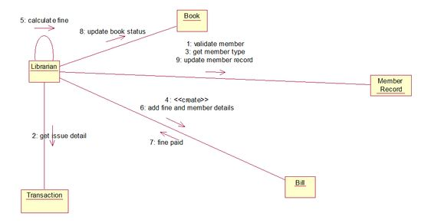
Collaboration diagram for lms

Slide 79
Collaboration : benefits
A communication diagram provides the following benefits:
They emphasize how lifelines connect.
They focus on elements within a system rather than message flow.
They provide an added emphasis on organization over timing.

Slide 80
Collaboration : drawbacks
A communication diagram provides the following benefits:
They emphasize how lifelines connect.
They focus on elements within a system rather than message flow.
They provide an added emphasis on organization over timing.

Slide 81
Interaction view: sequence diagram
From the term Interaction, it is clear that the diagram is used to describe some type of interactions among the different elements in the model. This interaction is a part of dynamic behavior of the system.

Slide 82
Sequence Diagram
To model high-level interaction among active objects within a system.
To model interaction among objects inside a collaboration realizing a use case.
It either models generic interactions or some certain instances of interaction.

Slide 83
Key parts of a sequence diagram
Participant: an object or an entity; the sequence diagram actor
sequence diagram starts with an unattached "found message" arrow
:Client
:Server
checkEmail
sendUnsentEmail
newEmail
response
Message: communication between objects
Axes in a sequence diagram:
[newEmail] get
deleteOldEmail
horizontal: which participant is acting
vertical: time (↓ forward in time)
5

Slide 84
Key parts of a sequence diagram
Participant: an object or an entity; the sequence diagram actor
sequence diagram starts with an unattached "found message" arrow
:Client
:Server
checkEmail
sendUnsentEmail
newEmail
response
Message: communication between objects
Axes in a sequence diagram:
[newEmail] get
deleteOldEmail
horizontal: which participant is acting
vertical: time (↓ forward in time)
5

Slide 85
Sequence diagram from a use case
The user presses the “check email” button.
The client first sends all unsent email to the server.
After receiving an acknowledgement, the client asks the server if there is any new email.
If so, it downloads the new email.
Next, it deletes old thrashed email from the server.
:Client
:Server
checkEmail
sendUnsentEmail
newEmail
response
[newEmail] getEmail
deleteOldEmail
6

Slide 86

From use-case diagram

Slide 87

Notations of a Sequence Diagram
Lifeline
An individual participant in the sequence diagram is represented by a lifeline. It is positioned at the top of the diagram.

Slide 88

Actor
A role played by an entity that interacts with the subject is called as an actor. It is out of the scope of the system. It represents the role, which involves human users and external hardware or subjects. An actor may or may not represent a physical entity, but it purely depicts the role of an entity. Several distinct roles can be played by an actor or vice versa.

Slide 89

Object name
An object can be named in one of three ways: the object name, the object name and its class, or just the class name (anonymous object). The three ways of naming an object are shown in Figure below.

Slide 90




Representing objects
objectname:classname
Named object
Anonymous object
Smith:Patient
:Patient
Smith
Object of unknown class
8

Slide 91
Representing objects
objectname:classname
An object: a box with an underlined label that specifies the object type, and optionally the object name.
Write the object's name if it clarifies the diagram.
Named object
Anonymous object
Smith:Patient
:Patient
Smith
Object of unknown class
8

Slide 92

Representing objects
objectname:classname
An object's "life line" is represented by a dashed vertical line.
Represents the life span of the object during the scenario being modeled.
Named object
Anonymous object
Smith:Patient
:Patient
Smith
Object of unknown class
Lifeline
8

Slide 93
Activation/ focus of control
:Controller
Activation: thick box over object's life line, drawn when an object's method is on the stack
Either that object is running its code,
or it is on the stack waiting for another object's method to finish
:Controller
Nest activations to indicate an object calling itself.

Slide 94
Messages
Messages (or signals) on a sequence diagram are specified using an arrow from the participant (message caller) that wants to pass the message to the participant (message receiver) that is to receive the message
A Message (or stimulus) is represented as an arrow going from the sender to the top of the focus of control (i.e., execution occurrence) of the message on the receiver’s lifeline

Slide 95
Message Type Notations
Message | Description
 | Synchronous: A synchronous message between active objects indicates wait semantics; the sender waits for the message to be handled before it continues. This typically shows a method call.
 | Asynchronous: With an asynchronous flow of control, there is no explicit return message to the caller. An asynchronous message between objects indicates no-wait semantics; the sender does not wait for the message before it continues. This allows objects to execute concurrently.
 | Reply: This shows the return message from another message.

Slide 96
Message Type Notations
Message | Description
 | Create: This message results in the creation of a new object. The message could call a constructor for a class if you are working with Java, for example.
 | Lost: A lost message occurs whet the sender of the message is known but there is no reception of the message. This message allows advanced dynamic models to built up by fragments without complete knowledge of all the messages in the system. This also allows the modeler to consider the possible impact of a message’s being lost.
 | Found: A found message indicates that although the receiver of the message is known in the current interaction fragment, the sender of the message is unknown.

Slide 97
Message Type Notations
Element Creation: when an element is created during an interaction, the communication that creates the element is shown with its arrowhead to the element
Element Destruction: When an element is destroyed during an interaction, the
communication that destroys the element is shown with its arrowhead to the
elements lifeline where the destruction is marked with a large × symbol

Slide 98

Messages
The messages depict the interaction between the objects and are represented by arrows. They are in the sequential order on the lifeline. The core of the sequence diagram is formed by messages and lifelines.
Following are types of messages enlisted below:
Call Message: It defines a particular communication between the lifelines of an interaction, which represents that the target lifeline has invoked an operation.

Slide 99

Messages
Return Message: It defines a particular communication between the lifelines of interaction that represent the flow of information from the receiver of the corresponding caller message.

Slide 100

Messages
Self Message: It describes a communication, particularly between the lifelines of an interaction that represents a message of the same lifeline, has been invoked.

Slide 101

Messages
Create Message: It describes a communication, particularly between the lifelines of an interaction describing that the target (lifeline) has been instantiated.

Slide 102

Messages
Destroy Message: It describes a communication, particularly between the lifelines of an interaction that depicts a request to destroy the lifecycle of the target.

Slide 103

Messages
Duration Message: It describes a communication particularly between the lifelines of an interaction, which portrays the time passage of the message while modeling a system.

Slide 104

Note
A note is the capability of attaching several remarks to the element. It basically carries useful information for the modelers.

Slide 105

Sequence diagram for lms

Slide 106
Example: Place Order
The example shows a Sequence diagram with three participating objects: Customer, Order, and the Stock. Without even knowing the notation formally, you can probably get a pretty good idea of what is going on.
Step 1 and 2: Customer creates an order.
Step 3: Customer add items to the order.
Step 4, 5: Each item is checked for availability in inventory.
Step 6, 7, 8 : If the product is available, it is added to the order.
Step 9 return
Step 10, 11: save and destroy order

Slide 107

Example: Place Order

Slide 108

Sequence Fragments
introduces sequence (or interaction) fragments. Sequence fragments make it easier to create and maintain accurate sequence diagrams
A sequence fragment is represented as a box, called a combined fragment, which encloses a portion of the interactions within a sequence diagram
The fragment operator (in the top left cornet) indicates the type of fragment
Fragment types: ref, assert, loop, break, alt, opt, neg

Slide 109
Operator | Fragment Type
alt | Alternative multiple fragments: only the one whose condition is true will execute.
opt | Optional: the fragment executes only if the supplied condition is true. Equivalent to an alt only with one trace.
par | Parallel: each fragment is run in parallel.
loop | Loop: the fragment may execute multiple times, and the guard indicates the basis of iteration.
region | Critical region: the fragment can have only one thread executing it at once.
neg | Negative: the fragment shows an invalid interaction.
ref | Reference: refers to an interaction defined on another diagram. The frame is drawn to cover the lifelines involved in the interaction. You can define parameters and a return value.
sd | Sequence diagram: used to surround an entire sequence diagram.

Slide 110
Example - Place Order Scenario
A member of a ship who would like to place an order online. The item ordered will be sent to the member either send by courier or by ordinary mail depending on she member status (VIP, Ordinary membership). Optionally, the shop will send the member a confirmation notification if the member opted for the notification option in the order.

Slide 111

Combined Fragment Example

Slide 112
Interaction view: types
Timing Diagram is a waveform or a graph that is used to describe the state of a lifeline at any instance of time. It is used to denote the transformation of an object from one form into another form. Timing diagram does not contain notations as required in the sequence and collaboration diagram

Slide 113
Timing diagram

Slide 114
Interaction view: types
The interaction overview diagram provides a high-level view of an interaction model. The diagram acts as an overview of the flow of control from interaction to interaction, as well as the flow of activity from diagram to diagram.

Slide 115
Interaction overview diagram

Slide 116

Online bookstore example
The customer begins the interaction by searching for a book by title.
The system will return all books with that title.
The customer can look at the book description.
The customer can place a book in the shopping cart.
The customer can repeat the interaction as many times as desired.
The customer can purchase the items in the cart by checking out.

Slide 117
In class exercise
Draw a sequence diagram for:
In Beauty and the Beast kitchen items came to life. Draw a sequence diagram for making a peanut butter and jelly sandwich if the following objects are alive: knife, peanut butter jar (and peanut butter), jelly jar (and jelly), bread, plate. I may or may not want the crusts cut off. Don’t forget to open and close things like the jars, and put yourself away, cleanup, etc…

Slide 118
In class exercise
Draw a sequence diagram for:
Returning a movie to Netflix. When you return it a person scan’s it in, the s/w detects that and then goes through a sequence of steps to get the new movie to you. Think of the different classes that would be involved: Queue, Shipping, Inventory, UserAccount, other classes??

Slide 119
In class exercise
Draw a sequence diagram for:
Adding a picture to Flickr (or any online image database). Login, pick an album, upload a picture, etc… Think about the software classes that would be involved – WebGUI (think of this as reporting what the user does), UserAccount, Album, AlbumList, etc…
Don’t forget to check and update their current disk usage. For this diagram show the check coming back as acceptable.. you would do a second diagram for them running over quota.

Slide 120
In class exercise
Draw a sequence diagram for:
Getting on a flight. Start at home, check in at the counter, go through security, and end up at the gate. (If you have time during the exercise, get yourself to your seat.)
You may get searched in security

Slide 121
Thank you

